Slide 1
Chapter 4: IO Management
An operating system is the core set of software on a device that keeps everything together and communicate with the device’s hardware.
One of the important jobs of an Operating System is to manage various I/O devices.
The operating system sits in between the applications you run and the hardware, using the hardware drivers as the interface between the two.
For example, when an application wants to print something, it is task of the operating system, that It sends the instructions to the printer, using the printer’s drivers to send the correct signals.

Slide 2
Device drivers
Device Driver is special or specific types of software application which controls a specific hardware device that enables different hardware devices to communication with the computer’s Operating System.
Device drivers works within the kernel layer of the operating system. The kernel of the OS interacts with the I/O device through the device driver. Only the device driver knows the details of the I/O devices.
Device driver is a program via which the operating system communicates with the device controller.
Each driver contains the device specific codes required to carry out the actions on the device.
Operating systems use device drivers written by hardware creators to communicate with their devices.

Slide 3
Cont…
Instead of accessing a device directly, an operating system loads the device drivers and calls the specific functions in the driver software in order to execute specific tasks on the device.
Thus every application may make a common call to devices but the operating system receives that call and use the corresponding drivers to translate the call into action needed for underlying hardware.
Device Drivers are very essential for a computer system to work properly because without device driver the particular hardware fails to work accordingly.
That means hardware without driver fails in doing a particular function/action for which it has been created.
When we get a peripheral device such as printer, scanner, keyboard, the device comes together with a driver CD which needs to be installed before the device starts working.

Slide 4
Cont…
I/O devices can be divided into two categories
Block devices − is one with which the driver communicates by sending entire blocks of data.
For example, Hard disks, USB cameras and etc.
Character devices − is one with which the driver communicates by sending and receiving single characters with the devices.
For example, serial ports, parallel ports, keyboard and etc.

Slide 5
Types of Device Driver:
1. Kernel-mode Device Driver
This device driver includes some generic hardwares which loads with operating System as part the OS these are BIOS, motherboard, processor and some other hardwares which are part of kernel software.
User-mode Device Driver
Other than the devices which are brought by kernel for working of the system the user also bring some devices for use during the using of a system that devices needs device drivers to functions those drivers falls under User mode device driver.
For example user needs any plug and play action that comes under this.

Slide 6
Device Controllers/Adaptor
Device controller is a hardware unit attached to the I/O bus of the computer and works like an interface between a device and a device driver.
The operating system initializes the controller with a few parameters (such as number of characters per line and etc).
For each device controller there is an equivalent device driver which is the standard interface through which the device controller communicates with the Operating Systems.
A device controller may be able to handle multiple devices.
controller is a hardware whereas driver is a software. The controller's job is to convert the serial bit stream to block bytes. In case of serial device, the controller collects a serial bit stream, converts it into a block of bytes and performs necessary error correction.

Slide 7
Cont…
Any device connected to the computer is connected by a plug and socket, and the socket is connected to a device controller that has a local buffer and special purpose registers.
The Device Controller receives the data from a connected device and stores it temporarily in some special purpose registers (i.e. local buffer) inside the controller.
It is a hardware that is mainly utilized to connect a computer's OS and functions in the phase by connecting the device and the device driver.
The device controller is responsible for moving the data between the peripheral devices that it controls and its local buffer storage.

Slide 8
Cont…
The CPU communicates with the I/O device through device controller of that device by sending signals to device controller to perform a specific I/O operation such as read or write operation.
CPU moves data from/to main memory to/from local buffers I/O buffer of controller.
Each controller has one or more registers that are used for communicating with the CPU.
That means, communication with devices carried out through device registers

Slide 9
Cont…
Device controller contains registers for communication with that device associated with each port.
Command register : issue a command to the device by writing a particular value to this register.
Data register : used to transfer larger blocks of data to/from the device.
Data-in register ___to get input from the device.
Data-out register___ to send output.
3. Control register — to tell it what to do. to change settings of the device such as parity checking, word length, or full- versus half-duplex operation.
4. Status register —tells you something about the device’s current state typically, a status register is read. It has bits read by the host to determine the status of the device, such as idle, ready for input, busy, error, transaction complete, etc.

Slide 10
Synchronous and asynchronous I/O operations on a data.
Transfer of data is required between CPU and peripherals or any two units of computer system. This data transfer with the computer is Internal Operation.
This Internal Operation of data transfer in computer system can be either
Synchronous or
Asynchronous

Slide 11
synchronous I/O
When both the transmitting and receiving units use same clock pulse then such a data transfer is called Synchronous process.
For synchronous I/O operations, the process calling the I/O request is blocked until the I/O operation is complete and regains control of execution only when the request is completely satisfied.
In this organization, CPU execution waits while I/O proceeds which is so called blocking I/O. I.e. it would block the progress of a program while the communication is in progress, leaving system resources idle.
When a program makes many I/O operations (such as a program mainly or largely dependent on user input), this means that the processor can spend almost all of its time idle waiting for I/O operations to complete.

Slide 12
Asynchronous I/O
On the other hand, if sender operates at different moment than the receiver then such a data transfer is called Asynchronous data transfer.
For asynchronous I/O operations, the process calling the I/O request immediately regains control of execution once the I/O operation is queued to the device.
Asynchronous I/O is also non-sequential I/O is a form of input/output processing that permits other processing to continue before the transmission has finished. i.e. I/O proceeds concurrently with CPU execution.
This Scheme is used when speed of I/O devices do not match with microprocessor and (I/O) operations on a computer can be extremely slow compared to the processing or execution of data.
Instead, it is possible to start the communication and then perform processing that does not require that the I/O be completed. This approach is called asynchronous input/output.

Slide 13
Cont…
Any task that depends on the I/O having completed still needs to wait for the I/O operation to complete, and thus is still blocked, but other processing that does not have a dependency on the I/O operation can continue.
In this method, process initiates the device and check its status. As a result, CPU has to wait till I/O device is ready to transfer data.
In this method two types of techniques or protocols are used based on signals before data transfer.
Strobe Control Employs a single control line to time each transfer. The strobe may be activated by either the source or the destination unit.
Handshaking Solves the problem of strobe method by introducing a second control signal that provides a reply to the unit that initiates the transfer.

Slide 14
Cont…
With Asynchronous the transfer of data between two units is either serial or parallel.
In parallel data transmission, n bit in the message must be transmitted through n separate conductor path.
In serial transmission, each bit in the message is sent in sequence one at a time.
The start and the stop bit is introduced in the message during transmission with Asynchronous. That ensure the data is transmitted correctly from the sender to the receiver.
Each bit of message is sent at a time, and binary information is transferred only when it is available. When there is no information to be transferred, line remains idle.
Example with serial technique each character consists of three points :

Slide 15
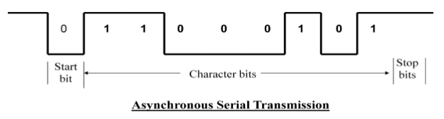
Cont…
Start bit - First bit, called start bit is always zero and used to indicate the beginning character.
Character bit .Bits in between the start bit and the stop bit are known as character bits. The character bits always follow the start bit.
Stop bit – Last bit, called stop bit is always one and used to indicate end of characters. Stop bit is always in the 1- state and frame the end of the characters to signify the idle or wait state.

Slide 16
Mode of data transfer
The data transfer can be handled by various modes. Some of the modes use CPU as an intermediate path, while others transfer the data directly to and from the memory unit. So, This can be handled by 3 ways:
Programmed I/O
Interrupt-Initiated I/O
Direct Memory Access (DMA)

Slide 17
Programmed I/O Mode:
In this mode the data transfer is initiated by the instructions written in a computer program and the operations are the results in I/O instructions.
An input instruction is required to store the data from the device to the CPU and a store instruction is required to transfer the data from the CPU to the device.
Normally the transfer is from a CPU register to peripheral device or vice-versa. So, once the data is initiated the CPU starts monitoring the interface to see when the next transfer can made.
Thus CPU stays in a loop until the I/O device indicates that it is ready for data transfer.

Slide 18
Cont…
The main drawback of the Program Initiated I/O was that the CPU has to monitor the units all the times when the program is executing.
Thus the CPU stays in a program loop until the I/O unit indicates that it is ready for data transfer.
This is a time consuming process and the CPU time is wasted a lot in keeping an eye to the executing of program.

Slide 19
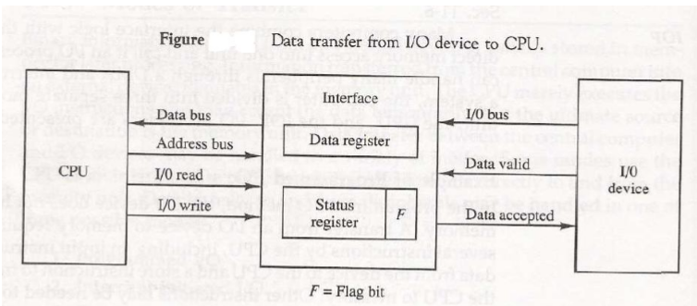
Cont…

Slide 20
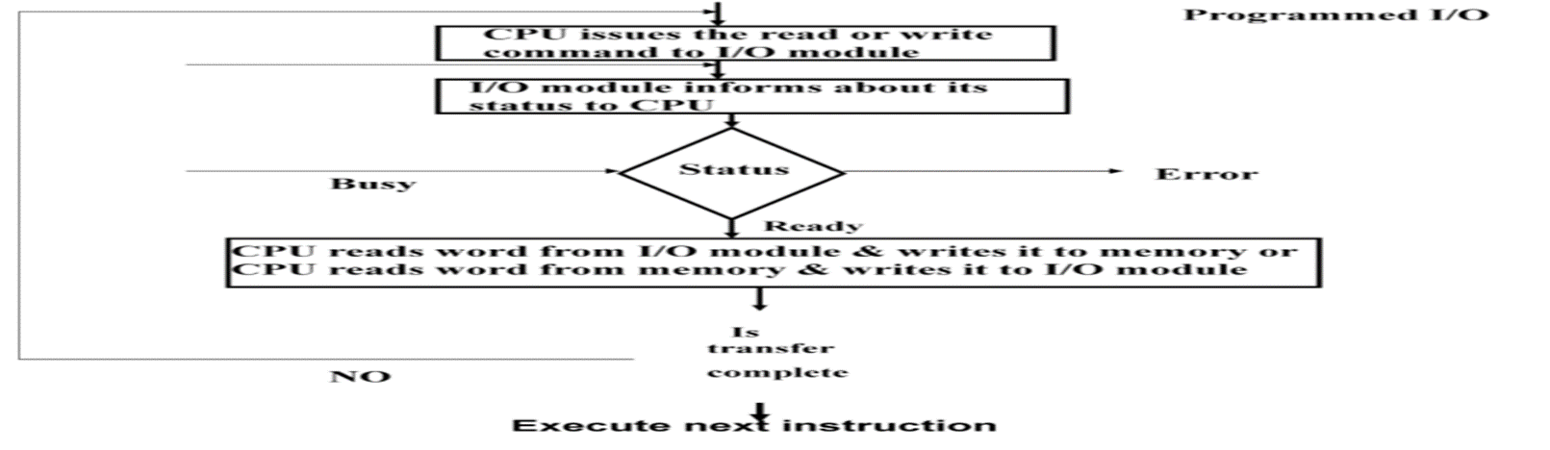
Cont…

Slide 21
Example
The control of transfer of data from an external devices to processor may involve the following sequences of steps.
The processor interact with the i/o modules ( interfaces ) to check the status of attached i/o devices.
The i/o devices return the status of device.
If the device is operational and ready to transmit, the processor requests the transfer of data by means of command to i/o modules.
The i/o module obtain the unit of data from external devices.
The data are transferred from i/o module to the processor.

Slide 22
Interrupt-Initiated I/O
Data transfer between the CPU and the peripherals is initiated or started by the CPU. But the CPU cannot start the transfer unless the peripheral is ready to communicate with the CPU.
When a device is ready to communicate with the CPU, it generates an interrupt signal. A number of input-output devices are attached to the computer and each device is able to generate an interrupt request.
So, An interrupt is a signal to the processor emitted by hardware or software indicating an event that needs immediate attention.
When the interface determines that the device is ready for data transfer it generates an Interrupt Request and sends it to the processor.
When the CPU receives such an signal, it temporarily stops the execution of the current program and branches to a service program to process the I/O transfer.
The CPU responds to the signal by storing the return address from the program counter (PC) into the memory stack and then branches to service that processes the I/O request.

Slide 23
Cont…
So, interrupt causes the CPU to move away from what it is doing to respond to the I/O transfer and after completing it returns back to task, what it was originally performing.
In this mode, without an interrupt request, a computer will remain in its current state. Each input signal causes an interrupt, forcing the CPU to process the corresponding event.
In the meantime CPU keeps on executing other tasks and need not check for the flag. When the flag is set, the interface is informed and an interrupt is initiated.
When the CPU receives such signal, it temporarily stops the execution of the program and branches to a service program to process the I/O transfer.
The branch address of the service can be chosen in two ways.
vectored and
non-vectored interrupt.

Slide 24
vectored interrupt
vector is a memory location at which the address of the ISR can be found.
So, Devices that use vector interrupts are assigned an interrupt vector witch is a number that identifies a particular interrupt handler.
A device controller puts an interrupt signal on the bus when it needs CPU’s attention when CPU receives an interrupt, It saves its current state and invokes the appropriate interrupt handler using the interrupt vector (addresses of OS routines to handle various events).
When microprocessor executes the call instruction, it save address of the next instruction in the stack and start with ISR. At the end of the service routine, the RET instruction returns the execution to where the program was interrupted.
In the vector interrupt, ISR address of this interrupts is fixed and known to CPU. So, When the device interrupt the CPU, it branches to the particular ISR. That mean The microprocessor jumps to the specific service routine.

Slide 25
Cont…
In vectored interrupt, the source that interrupts, supplies the branch information to the CPU while in case of non-vectored interrupt the branch address is assigned to a fixed location in memory.
Interrupting devices send its unique vector through its data bus and through its i/o interface to the CPU.
The CPU take this vector and checks an interrupt table in a memory and then carry out the correct ISR for that device.

Slide 26
In this case what is an interrupt handler?
An Interrupt handler is also called an interrupt service routine or ISR which is a software process or special block of code associated with a specific interrupt condition that is invoked by an interrupt request from a hardware device.
It is the function that the kernel runs in response to a specific interrupt: Each device that generates interrupts has an associated interrupt handler.
The interrupt handler for a device is part of the device's driver (the kernel code that manages the device).
It handles the request and sends it to the CPU, interrupting the active process. When the ISR is complete, the process is resumed.

Slide 27
Cont…
A basic example of an ISR is a routine that handles keyboard events, such as pressing or releasing a key.
Each time a key is pressed, the ISR processes the input. For example, if you press and hold the right arrow key in a text file, the ISR will signal to the CPU that the right arrow key is depressed.
The CPU sends this information to the active word processor or text editing program, which will move the cursor to the right.
When you let go of the key, the ISR handles the "key up" event. This interrupts the previous "key down" state, which signals to the program to stop moving the cursor.

Slide 28
2. non-vectored interrupt.
Non-Vectored Interrupts are those in which vector address is not predefined.
It is an interrupt that has a common ISR which is common to all non-vector interrupts in the system. Address of this common ISR is known to CPU.
The interrupts which do not have fixed memory location for transfer of control from normal execution.
The CPU does not know which devices caused the interrupt without polling each input/output interface in a loop in status flag.
Once the interrupt occurs, the system must determine which device of all devices associated actually interrupted.
Polling is the simplest way for an I/O device to communicate with the processor.
The process of periodically checking status of the device to see if it is time for the next I/O operation, is called polling.
The I/O device simply puts the information in a Status register, and the processor must come and get the information.

Slide 29
Types of Interrupts
Hardware Interrupts
When the signal for the processor is from an external device or hardware then this interrupts is known as hardware interrupt.
Example: when we press any key on our keyboard to do some action, then this pressing of the key will generate an interrupt signal for the processor to perform certain action. Such an interrupt can be of two types:
Maskable Interrupt
The hardware interrupts which can be delayed when a much high priority interrupt has occurred at the same time.
Non Maskable Interrupt
The hardware interrupts which cannot be delayed and should be processed by the processor immediately.

Slide 30
Software Interrupts
A software interrupt is invoked by software, unlike a hardware interrupt, and is considered one of the ways to communicate with the kernel or to invoke system calls, especially during error or exception handling.
It is invoked by the use of INT instruction. This event immediately stops execution of the program and passes execution over to the INT handler.
The INT n instruction is the general mnemonic for executing a software-generated call to an interrupt handler. It takes the interrupt number formatted as a byte value.
The INT handler is usually a part of the operating system and determines the action to be taken.
Software interrupt can be of two types:
Normal Interrupt
The interrupts that are caused by software instructions are called normal software interrupts.
Exception
Unplanned interrupts which are produced during the execution of some program are called exceptions, such as division by zero.

Slide 31
Direct Memory Access (DMA):
In the Direct Memory Access (DMA) the interface transfer the data into and out of the memory unit through the memory bus.
The host issues a command to the DMA controller, indicating the location where the data is located, the location where the data is to be transferred to, and the number of bytes of data to transfer.
The DMA controller handles the data transfer, and then interrupts the CPU when the transfer is complete.
The transfer of data between a fast storage device such as magnetic disk and memory is often limited by the speed of the CPU.
Data transfer between the device and the system involves transferring data between the device and the processor register and then from the processor register to memory.
The transfer speed might not meet the needs of high-speed I/O devices because of the additional data copy involved.
Removing the CPU from the path and letting the peripheral device manage the memory buses directly would improve the speed of transfer. This transfer technique is called Direct Memory Access (DMA).

Slide 32
Cont…
During the DMA transfer, the CPU is idle and has no control of the memory buses. A DMA Controller takes over the buses to manage the transfer directly between the I/O device and memory.
The CPU may be placed in an idle state in a variety of ways. One common method widely used in microprocessor is to disable the buses through special control signals such as: Bus Request (BR) and Bus Grant (BG)
These two control signals in the CPU that facilitates the DMA transfer. The Bus Request (BR) input is used by the DMA controller to request the CPU.
When this input is active, the CPU terminates the execution of the current instruction and places the address bus, data bus and read write lines into a high Impedance state. High Impedance state means that the output is disconnected.
The CPU activates the Bus Grant (BG) output to inform the external DMA that the Bus Request (BR) can now take control of the buses to conduct memory transfer without processor.
When the DMA terminates the transfer, it disables the Bus Request (BR) line. The CPU disables the Bus Grant (BG), takes control of the buses and return to its normal operation.

Slide 33
Communication between CPU and I/O Devices
The CPU must have a way to pass information to and from an I/O device.
There are three approaches available to communicate with the CPU and Device.
Special Instruction I/O or port mapped I/O.
Memory-mapped I/O
Direct memory access (DMA)

Slide 34
Port-Mapped or Isolated I/O
When the I/O device address space is separate from the system memory address space.
The I/O device address is referred to as the port number when specified for these special instructions is called port-mapped I/O.
Here , special processor instructions, such as the IN and OUT instructions offered by the Intel processor, are used to transfer data between the I/O device and a microprocessor register or memory.
Intel has, for the most part, used the port mapped scheme for their microprocessors and Motorola has used the memory mapped scheme.
During operation, the device registers are accessed again and are programmed to process data transfer requests, which is called device control.

Slide 35
Cont…
IN and OUT transfer data between an I/O device and the microprocessor's accumulator (AL, AX or EAX).
This I/O method is also called isolated I/O because the memory space is isolated from the I/O space, thus the entire memory address space is available for application use.
I/O mapped I/Os have a separate address space from the memory. So, total addressed capacity is the number of I/Os connected and a memory connected.
Separate I/O-related instructions are used to access I/Os. A separate signal is used for addressing an I/O device.

Slide 36
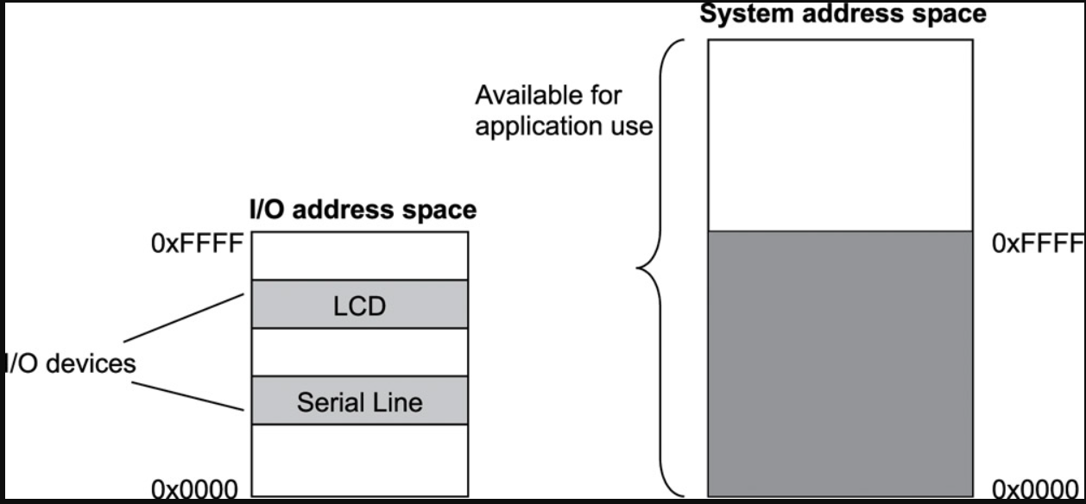
Cont…

Slide 37
example
IN AL, 19H ;8-bits are saved to AL from I/O port 19H.
IN EAX, DX ;32-bits are saved to EAX.
OUT DX, EAX ;32-bits are written to port DX from EAX.
OUT 19H,AX ;16-bits are written to I/O port 19H.

Slide 38
Memory-mapped I/O.
In which the device address is part of the system memory address space. Memory-mapped I/O uses the same address space to address both memory and I/O devices.
The memory and registers of the I/O devices are mapped to address values. So when an address is accessed by the CPU, it may refer to a portion of physical RAM, or it can instead refer to memory of the I/O device.
When using memory-mapped I/O, the same address space is shared by memory and I/O devices.
Any machine instruction that is encoded to transfer data between a memory location and the processor or between two memory locations can be used to access the I/O device.
In this case a certain portion of the processor's address space is mapped to the device, and communications occur by reading and writing directly to/from those memory areas.
I/O address space occupies a range in the system memory address space, this region of the memory address space is not available for an application to use.

Slide 39
Cont…
Memory-mapped I/Os share the memory space with external memory. So, total addressed capacity is memory connected only.
This is under utilization of resources if your processor supports Memory-mapped I/O.
Let's take an example of the 8085 processor. It has 16 address lines i.e. addressing capacity of 64 KB memory. It supports I/O-mapped I/Os. It can address up to 256 I/Os.
If we connect I/Os to it an I/O-mapped I/O then, it can address 256 I/Os + 64 KB memory. Here we fully utilize the addressing capacity of the processor.
If the peripherals are connected in memory mapped fashion, then total devices it can address is only 64KB.
This is underutilization of the resource. And only memory-accessing instructions like MOV, LOAD, SAVE are used to access the I/O devices.

Slide 40
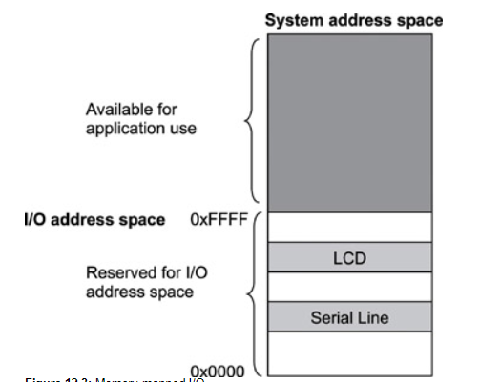
Cont…

Slide 41
SECONDARY STORAGE MANAGEMENT
Disk provide bulk of secondary storage of computer system. The disk can be considered the one I/O device that is common to each and every computer.
Disks come in many size and speeds, and information may be stored optically or magnetically.
By contrast, the hard drive is vastly larger in storage capacity and much faster.
It has to be because it holds the operating system, your application programs, and your data files.

Slide 42
Disk partition
Platters :-A hard disk driver consists of on one or more flat circular discs called platters on witch data is stored. Here different platters are stacked one above the other.
Track:- track is a circular path on the surface of a disk and is a portion of a disk which passes under a single stationary head during a disk rotation, a ring 1 bit wide.
Cylinder:- is comprised of the set of tracks described by all the heads (on separate platters) at a single seek position. Each cylinder is equidistant from the center of the disk.
Sectors:-track is divided into segments of sectors, which is the basic unit of storage.
Cluster:- A cluster consists of one or more sectors that the OS can allocate to a file.As sector is the basic unit of data storage on a hard disk. A single track typically can have thousands of sectors and each sector can hold more than 512 bytes of data.

Slide 43
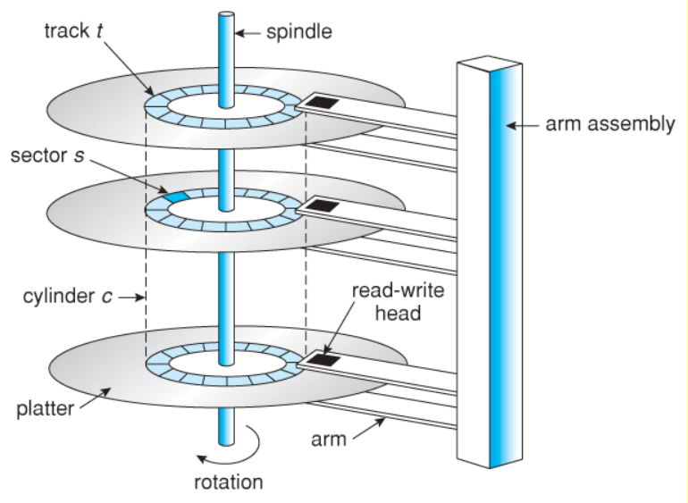
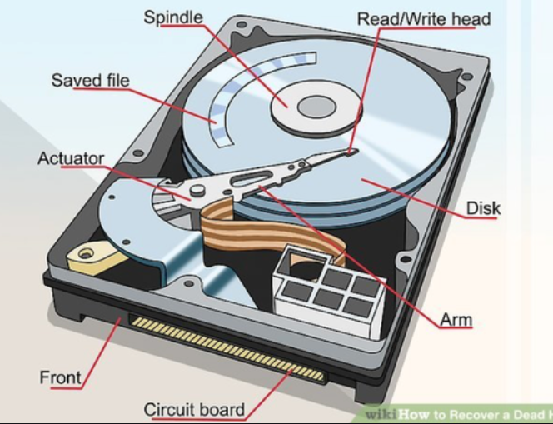
Cont..

Slide 44
Cont…
The number of sectors per track varies with the radius of the track on the platter.
The outermost tracks is larger and can hold more sectors than the inner ones.

Slide 45
Four key components of hard disk
The hard drive has four key components inside its casing.
The platter:- A hard disk drive contains several platters that are mounted on the same spindle.
The spindle :- for spinning or rotating the platters.
The read/write arm :- for reading and writing data
The actuator :- for controlling the actions of the read/write arm.

Slide 46
Disk Performance Parameters
Seek time: Seek time is the time required to move the disk arm to the required track.
It defined as the time required by the read/write head to move from one track to another.
Example
Consider the following diagram, the read/write head is currently on track 1.
Now, on the next read/write request, we may want to read data from Track 4, in this case, the read/write head will move to track 4.
The time it will take to reach track 4 is the seek time.

Slide 47
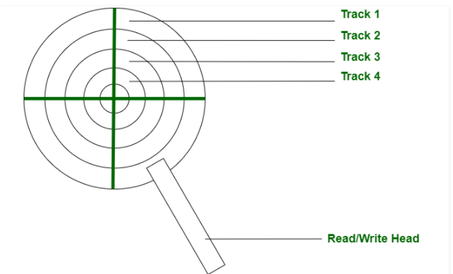
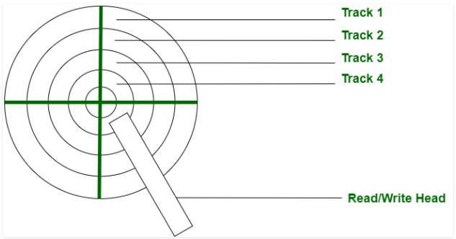
Cont..

Slide 48
Rotational delay
The disk is divided into many circular tracks, and these tracks are further divided into blocks knows as sectors.
The time required by the read/write head to rotate to the requested sector from the current position is called Rotational Latency.
Example,
Consider the following diagram, We have divided each track into 4 sectors.
The systems get a request to read a sector from track 1, thus the read/write head will move to track 1 and this time will be seek time and read/write head is currently in sector 3.
But the data may not be in sector 3 and may be present in sector 1. The time required by read/write head to move from sector 3 to sector 1 is the rotational latency.

Slide 49
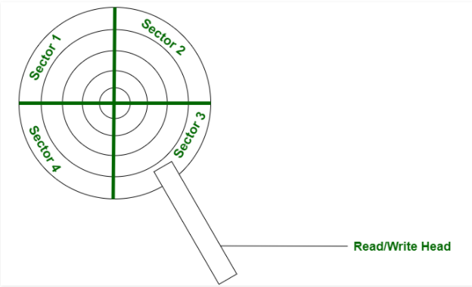
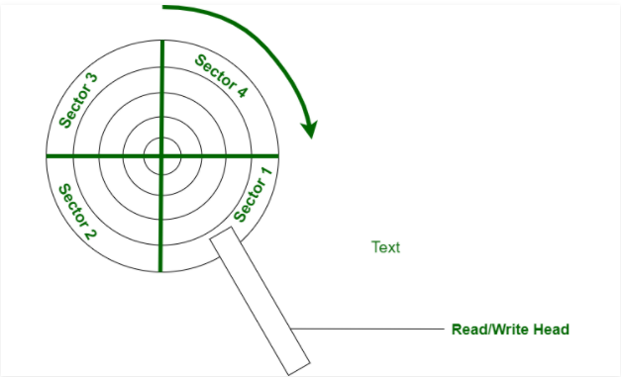
Cont…

Slide 50
3. Access time
Access time: the time from when a read or write request is issued to when data transfer begins.
To access data on a given sector of a disk, the arm first must move so that it is positioned over the correct track called seek time and then must wait for the sector to appear under it as the disk rotates is called rotational latency time.
The access time is then the sum of the seek time and the latency (Seek time + Rotational Latency).
4.Transfer time
Transfer time is a time required to transfer the required amount of data and calculated by the given formula.
Transfer time = Data to be transfer / transfer rate
Transfer rate, the rate at which data can be retrieved from or stored to the disk.
Transfer Rate= {(Number of heads or number of surfaces in the disk)*(capacity of one track or number of sectors in each track)*(Number of rotations in each track to reach the required sector).

Slide 51
Disk Management in OS
Disk Management is an important functionality provided by the Operating System which can be used to create, delete, format disk partitions and much more.
It enables users to manage and view the different disks and functions like viewing, creating, deleting, and shrinking the partitions associated with the disk drives.
Disk formatting:- is a process of configuring data storage device such as hard disk drive and other for initial use.
Disk Formatting is of two types.
Physical formatting or low level formatting.
Logical Formatting (high level formatting).

Slide 52
Physical Formatting (low-level formatting).
Low-level formatting is the process of marking out cylinders and tracks for a blank hard disk, and then dividing tracks into multiple sectors.
Disk must be formatted before storing data that means divided into tracks and sectors that the disk controllers can read/write which means dictates where data is stored on the disk.
So, this process is actually a kind of physical formatting. And it is now often performed by hard disk manufacturers i.e. Low level formatting is done at factory.
Short for low-level format, a formatting method that creates the tracks and sectors on a hard disk.

Slide 53
Logical Formatting (high-level formatting).
After disk is partitioned into low level formatting, logical formatting is used.
Logical formatting places a file system on the disk, allowing an operating system (such as DOS, OS/2, Windows, or Linux) to use the available disk space to store and retrieve files.
Operating system stores the initial file system data structures onto the disk.
Formatting hard disk usually done by user is the high-level formatting.

Slide 54
Disk scheduling Algorithms
Disk Scheduling or I/O Scheduling is the process of managing the I/O requests. Disk Scheduling Algorithms are different techniques used to manage these I/O requests.
If a device or controller is busy, any new requests for service will be placed on the queue of pending requests for that drive.
When one request is completed, the operating system chooses which pending request to service next.
There are mainly 6 types of disk scheduling algorithms.
1.First Come, First Served scheduling algorithm (FCFS).
2.Shortest Seek Time First (SSTF) algorithm
3.SCAN algorithm
4.Circular SCAN (C-SCAN) algorithm
5.Look Scheduling Algorithm
6.C-LOOK algorithm

Slide 55
FCFS Scheduling
FCFS is one of the simplest algorithms, which stands for First Come First Serve. As the name suggests, the I/O request that has come first will be served first. So, it serves the I/O requests in the order of their arrival.
All incoming requests are placed at the end of the queue. Whatever number that is next in the queue will be the next number served.
Simplest, perform operations by order of requested and no reordering of work queue.
no starvation: every request is serviced by order of arrival.
Ex: a disk queue with requests for I/O to blocks on cylinders 23, 89, 132, 42, 187 With disk head initially at 100.

Slide 56
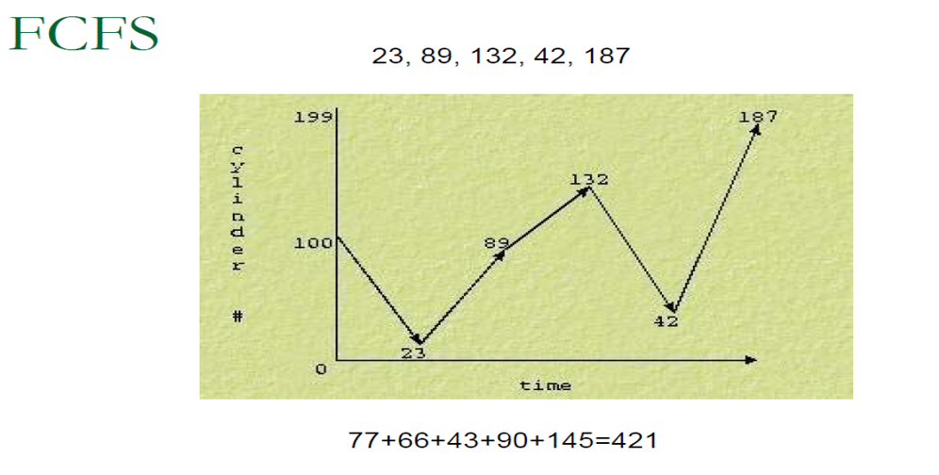
Cont…

Slide 57
SSTF Scheduling
SSTF is another algorithm that stands for Shortest Seek Time First. As the name suggests, the I/O requests having least seek Time are served first. In this case request is serviced according to next shortest distance.
Like SJF, select the disk I/O request that requires the least movement of the disk arm from its current position, regardless of direction reduces total seek time compared to FCFS.
Disadvantages
starvation is possible; stay in one area of the disk if very busy
switching directions slows things down
Not the most optimal

Slide 58
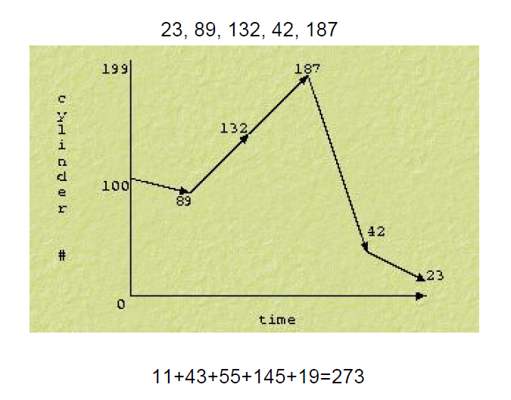
Cont…

Slide 59
SCAN
It scans down towards the nearest end and serves the I/O requests coming in its path then when it hits the bottom then reverses its direction and serves the I/O requests present in the path and scans up servicing the requests that it didn't get going down.
Since the movement of the Disk is like an elevator, it is also known as the Elevator Algorithm.
If a request comes in after it has been scanned it will not be serviced until the process comes back down or moves back up.

Slide 60
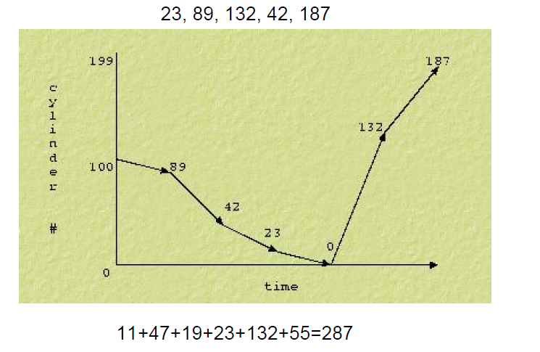
CONT…

Slide 61
C-SCAN
Circular scanning works just like the elevator to some extent. It begins its scan toward the nearest end and works it way all the way to the end of the system (end cylinder).
Un like the elevator, Once it hits the bottom or top of the system, the disk arm does not reverse its direction, rather it jumps to the other end and moves in the same direction.
In this, head or pointer works in a single direction i.e. it scans for the requests all the way to a direction and once it reaches the end, it jumps back to another end and services the requests in the same direction unlike, SCAN does it in both reversed and forward direction.
Keep in mind that the huge jump doesn't count as a head movement.

Slide 62
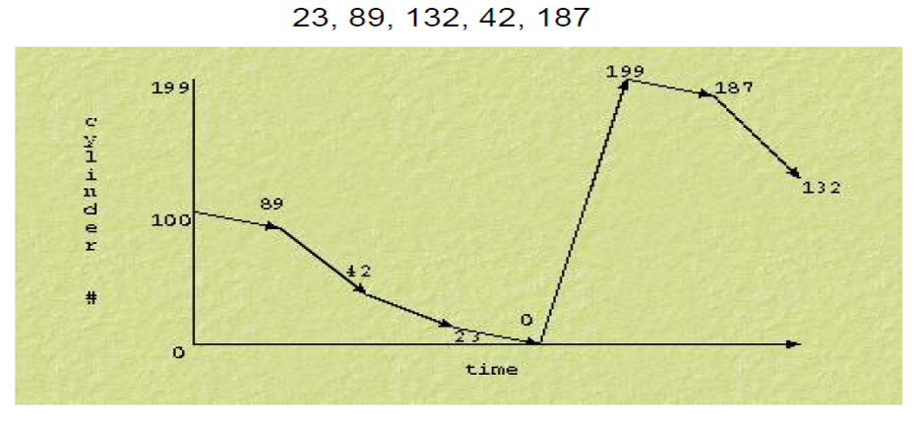
Cont…
11+47+19+23+12+55=167

Slide 63
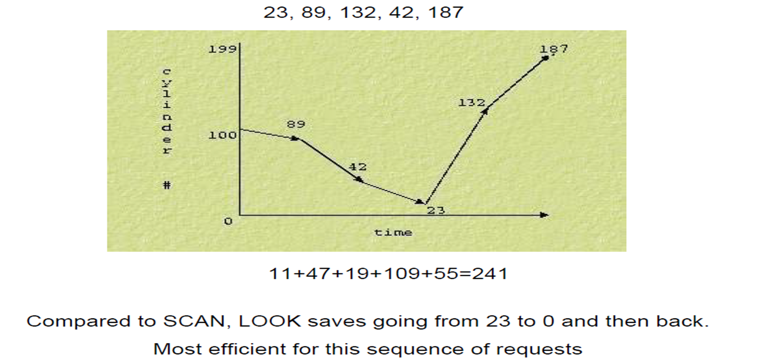
LOOK
like SCAN but stops moving inwards (or outwards) when no more requests in that direction exist.

Slide 64
C-LOOK
This is just an enhanced version of C-SCAN. In this the scanning doesn't go past the last request in the direction that it is moving.
It too jumps to the other end but not all the way to the end. Just to the furthest request.
Who sketch the symbolic diagram for this algorithm and calculate the total track moved by read write head?
The end
Thank you

